Slide 1

Spotify Sentiment Analysis
Exploring the correlation between song lyrics,their popularity and various acoustic features present in a song,collected from spotify in the MusicOSSet dataset using GCP
By
Samin Yasar
Shaon Prodhan
Ravindra Vadali
Nuobo Genpan
Shankar Nandy

Slide 2
Introduction
1
Objective
Classify Lyrics Sentiment into positive, neutral, or negative.
2
Platform
Google Cloud Platform (GCP) for scalable analysis.
Purpose
Gain insights into the significance of acoustic features of a song to the popularity and to their lyrics
3

Slide 3
Business Case Scenario
1
Company
Spotify: Global music streaming platform with over 500 million active users.
2
Goal
Streaming platforms like Spotify, Apple Music, or YouTube Music can enhance their recommendation engines by incorporating sentiment analysis of lyrics and acoustic features
3
Challenge
Manual analysis of millions of songs and their lyrics is time-intensive.
4
Solution
Automate sentiment analysis using cloud-based AI tools for efficient decision-making.

Slide 4




Key Solution Requirements
Scalability
Handle large data volumes efficiently with consistent performance.
Data Security
Ensure encrypted data transfer and compliance with privacy regulations.
Cost Efficiency
Optimize costs using pay-as-you-go cloud solutions.
Low Maintenance
Minimize operational overhead with automated cloud services.

Slide 5
Cloud vs On-Prem Matix
Feature | Cloud | On-Premise | Recommendation
Cost | Low | High | Cloud
Scalability | High | Low | Cloud
Maintenance | Low | High | Cloud
CAPEX | None | High | Cloud
OPEX | Medium | Medium | Tie
Security | High | Medium | Hybrid Solution
Setup | Low | High | Cloud

Slide 6
Cost Comparison GCP vs AWS
Cloud Storage
Service | GCP: Cloud Storage | AWS: S3
Storage Type | Standard Storage (Regional) | Standard Storage (S3 Standard)
Cost/GB | $0.023/GB/month | $0.023/GB/month
Example Usage | 1 TB stored | 1 TB stored
Monthly Cost | $23.00 | $23.00
NLP API
Service | GCP: Natural Language API | AWS: Comprehend
API Usage | Sentiment Analysis (up to 1K units) | Sentiment Analysis (up to 1K units)
Cost/1K Units | $1.00/1K units | $1.00/1K units
Example Usage | 100,000 units/month | 100,000 units/month
Monthly Cost | $100.00 | $100.00
Compute Engine
Service | GCP: Compute Engine | AWS: EC2
Instance Type | e2-standard-4 (4 vCPU, 16 GB RAM) | t3.xlarge (4 vCPU, 16 GB RAM)
Cost/Hour | $0.134/hour | $0.1344/hour
Example Usage | 730 hours (1 month, on-demand pricing) | 730 hours (1 month, on-demand pricing)
Monthly Cost | $97.82 | $98.11
Big Query
Service | GCP: BigQuery | AWS: Athena
Query Pricing | $5.00/TB (on-demand queries) | $5.00/TB (on-demand queries)
Example Usage | 10 TB queried per month | 10 TB queried per month
Monthly Cost | $50.00 | $50.00
Looker Studio
Service | GCP: Looker Studio (Free Tier) | AWS: QuickSight
Cost/User | Free (basic functionality) | $9.00/user/month (Standard Edition)
Example Usage | 5 users | 5 users
Monthly Cost | Free | $45.00

Slide 7
Cloud vs On-Prem Matix
Service | GCP Monthly Cost | AWS Monthly Cost
Cloud Storage | $23.00 | $23.00
Compute Engine | $97.82 | $98.11
NLP API | $100.00 | $100.00
BigQuery | $50.00 | $50.00
Looker Studio | Free | $45.00
Total | $270.82 | $316.11

Slide 8
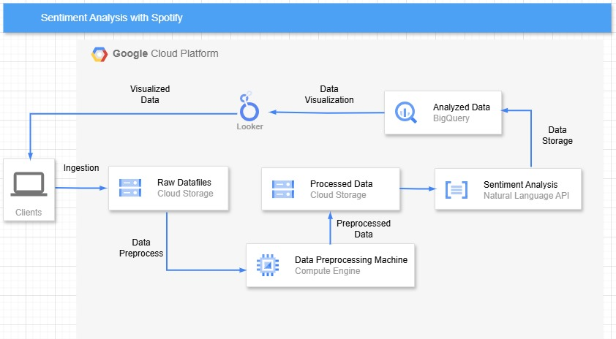
Solution Architecture

Slide 9




Project Workflow
Data Collection
Gather user feedback from various platforms.
Pre-processing
Clean and prepare data for analysis.
Sentiment Analysis
Apply NLP techniques to classify sentiments.
Visualization
Present insights using Looker Studio.

Slide 10
Dataset and Preprocessing
Dataset Overview
Preprocessing Steps
Optimization
20,000 Spotify songs reduced to 100 samples for analysis.
Cleaning, tokenization, and feature engineering simplify raw data.
Reduced MusicOSset dataset to essential features for faster processing/analysis.

Slide 11
Methodology Focus
Algorithm Choice
GCP Services
Utilization of Cloud Storage, Cloud Functions, Compute Engine, BigQuery ML, and more.
Natural Language Processing techniques applied for sentiment analysis.

Slide 12
Demo Solution: Data Processing and Analysis

Slide 13
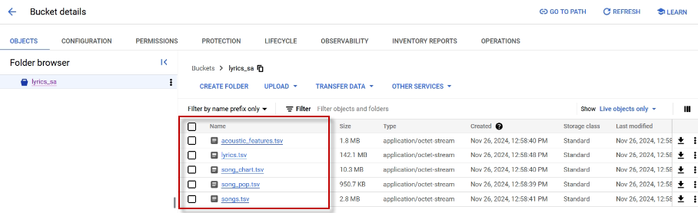
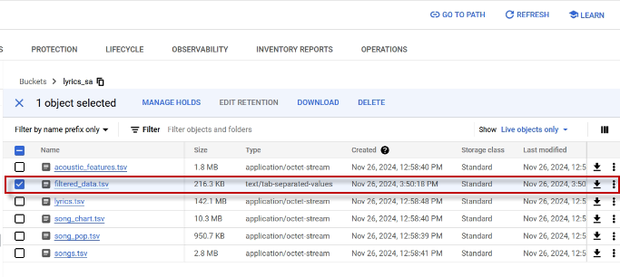
Data Upload and Filtering
1
Raw Data ( CSV)
CSV file will be uploaded to Cloud Storage.
2
Download Raw Data
Raw data downloaded to VM .
3
Merge Files
Merged into single file based on song ID.
4
Filter Songs
Remove Duplicates based on highest score.
5
Upload Cleaned Data
Cleaned data uploaded to bucket.

Slide 14

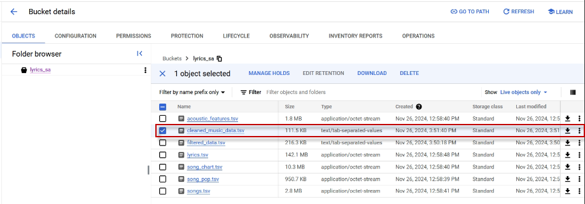


Data Pre-processing
Clean Data
Optimize data for learning process.
Pre-process
Prepare data for analysis.
Upload
Pre-processed data uploaded to cloud storage.

Slide 15
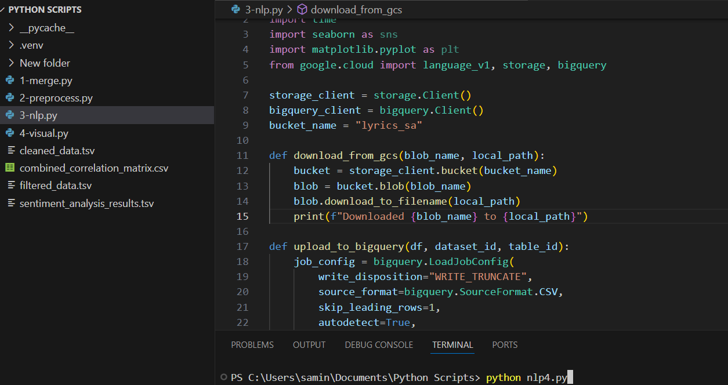
Natural Language Processing
1
Cloud API
Perform NLP using cloud natural language API.
2
Sentiment Analysis
Generate sentiment score and magnitude.
3
Prediction
Predict levels based on NLP results.

Slide 16
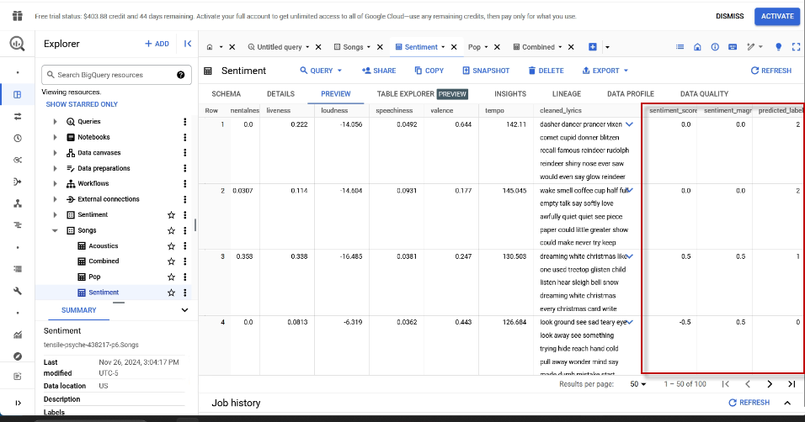
NLP Results Visualization
NLP has added the results highlighted here and which are shown in the dataset uploaded to Bigquery .

Slide 17
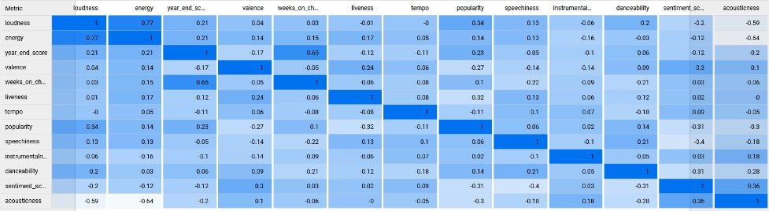
Data Visualization: Sentiment Correlation
Sentiment Correlation
Popularity Visualization
Label Visualization
Analyze correlation between sentiment and other song features.
Visualize relationship between popularity and sentiment of the lyrics.
Visualize relationship between labels and songs.

Slide 18
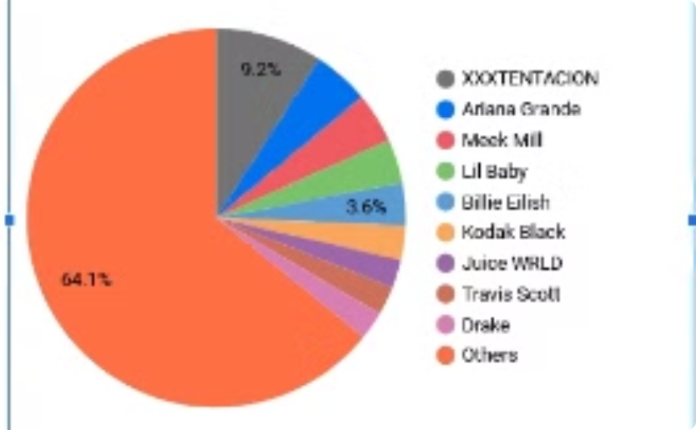
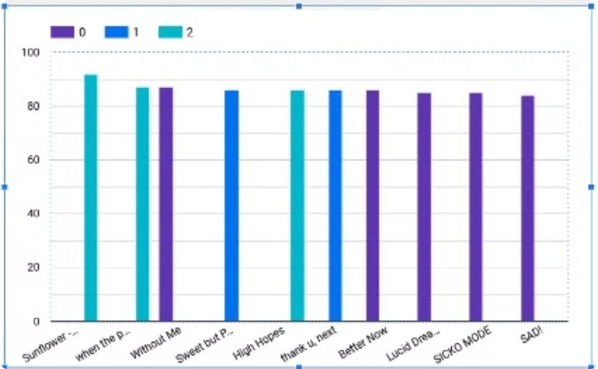
Data Visualization
Popularity Chart
Uniqueness
Chart visualizing popularity of songs. Color coded by their sentiment
The pie chart shows proportions for number
of unique songs from each artist present in our dataset

Slide 19
Challenges & Limitations
Language Constraints
Data Noise
Sample Size
Addressing inconsistent or unintelligible words in lyrics
Limitations in analyzing non-English reviews.
Potential bias from reduced dataset of 100 songs.
Mitigation Strategies
Implementing techniques to improve accuracy despite limitations.

Slide 20



Future Scope
Real-time Analysis
Language Expansion
Advanced Models
Implement streaming data for up-to-the-minute sentiment insights.
Develop capabilities to analyze non-English reviews accurately.
Explore transformer models for nuanced sentiment understanding.

Slide 21
Thank You

